Slide 1

Logistics Analytics

Slide 2
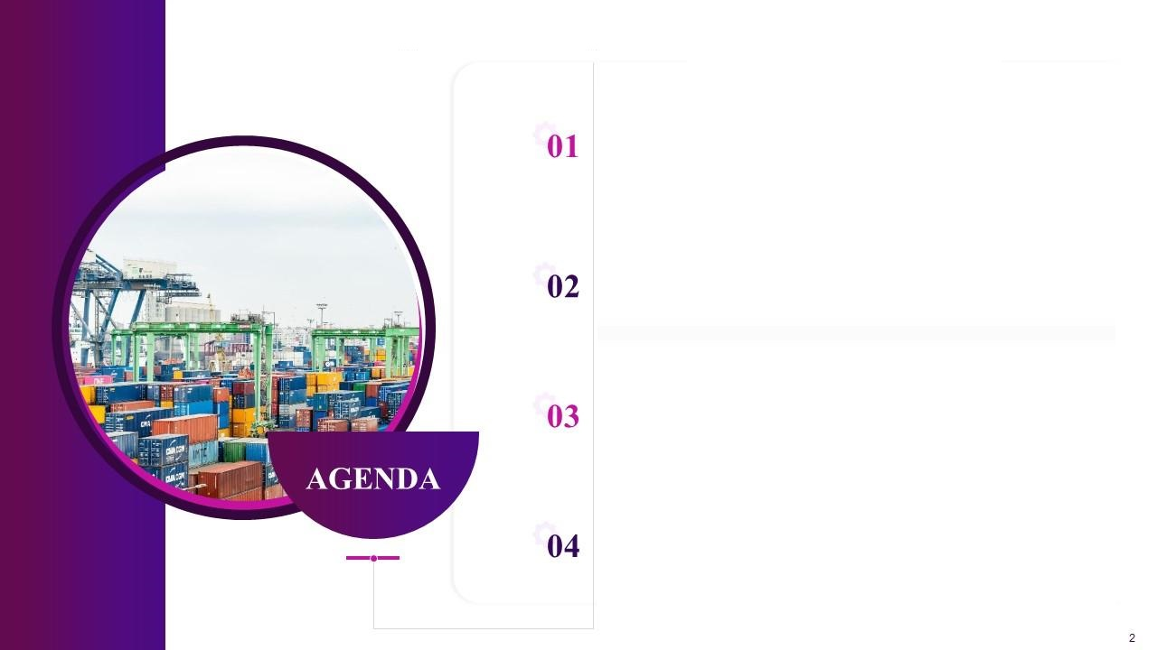
Introduction
Delivery App
Truck Delivery
ETL - Data Flow

Slide 3
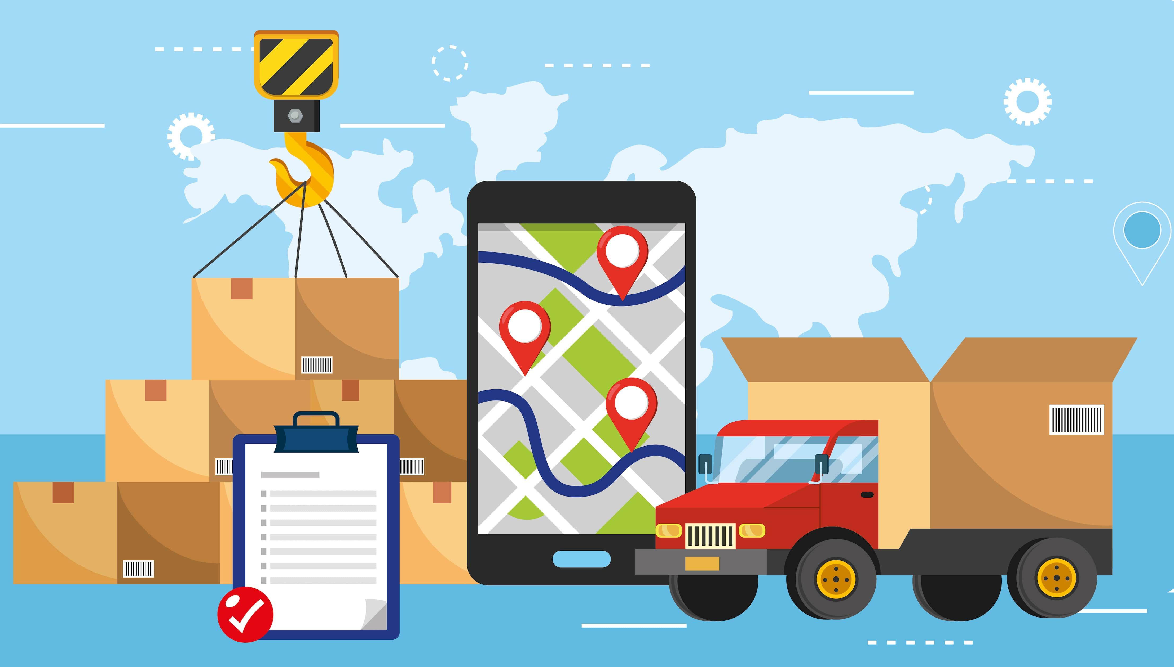
A consultancy
You ( As a Business Intelligence Analyst)
Client
Delivery App
DELIVERY APP
Data Source : Enterprise DNA and Maps data
Link

Slide 4

You are working at a consultancy that implemented an app for a client to help them improve their delivery process and fulfilment from warehouses to store.
The app was the created so that drivers could scan the label as opposed to entering it manually while also recording the time of arrival, the time they left the store and some other variables that the management were interested in improving.
The management is now looking to evaluate how the business has reacted and how effective the app is.
The senior consultant has extracted all data from the app and placed it into the file as below.
You now have you to use this data and create a report or dashboard to help management visualize what is happening so that we can decide what the next stage of the transformation is.
The management are particularly interested in any warehouse store combination that it’s not working well for.

Slide 5


Slide 6

Delivery Truck Trip
Data Source : Kaggle
Link​

Slide 8
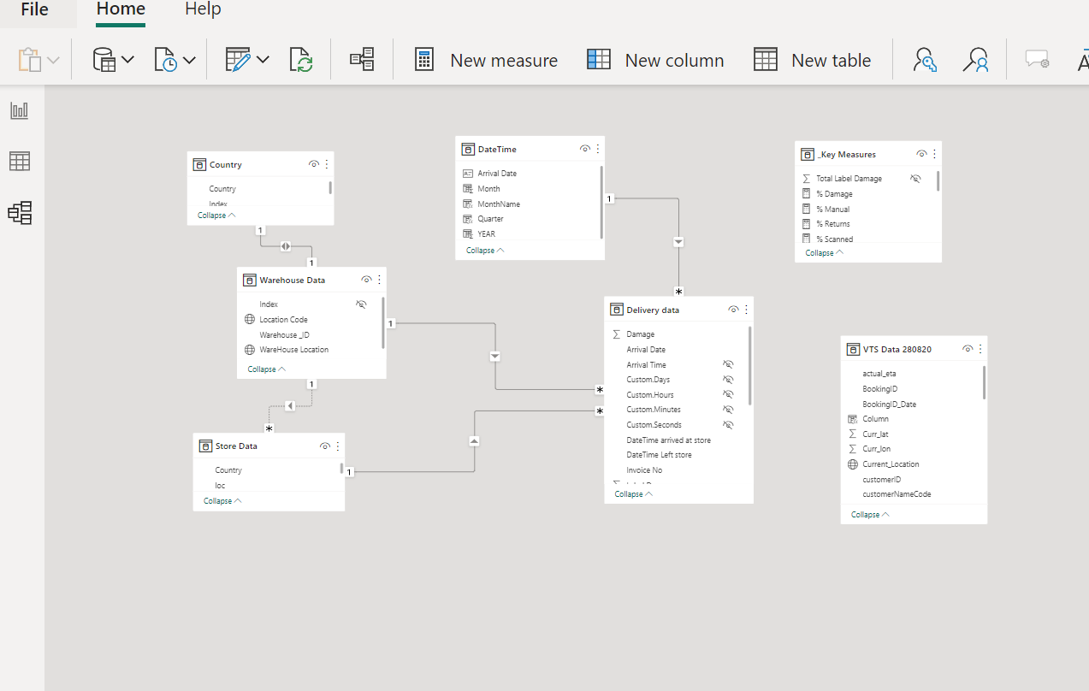
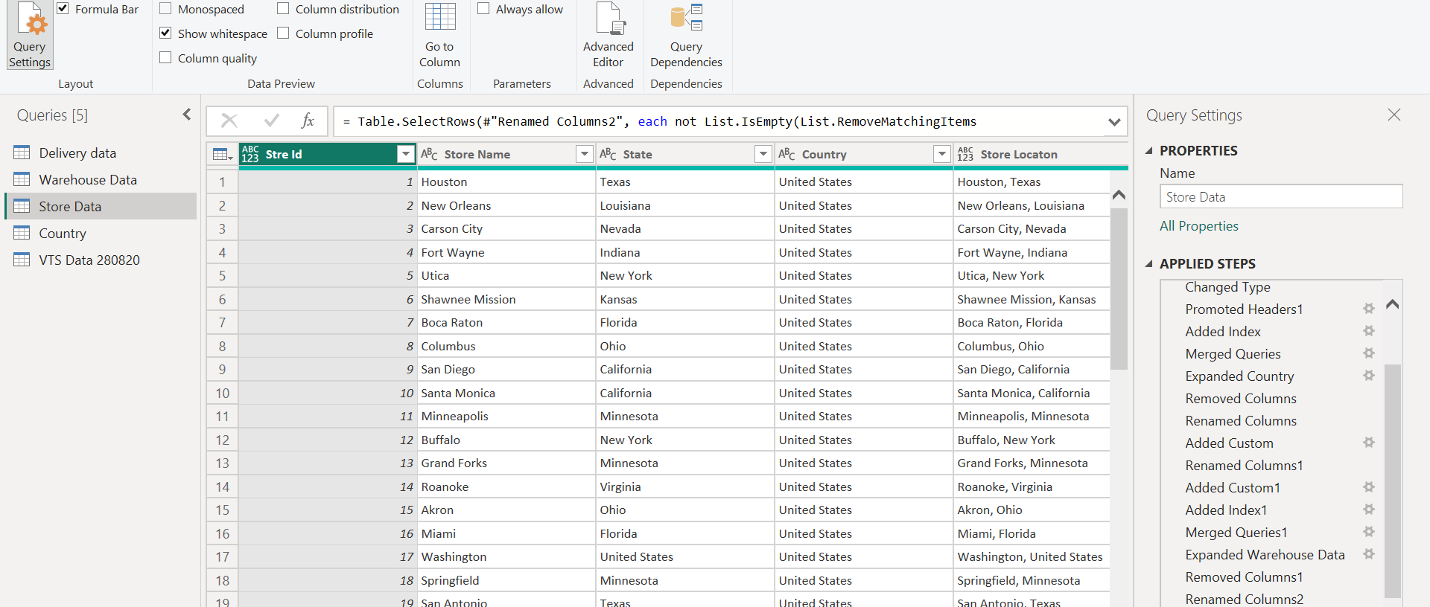

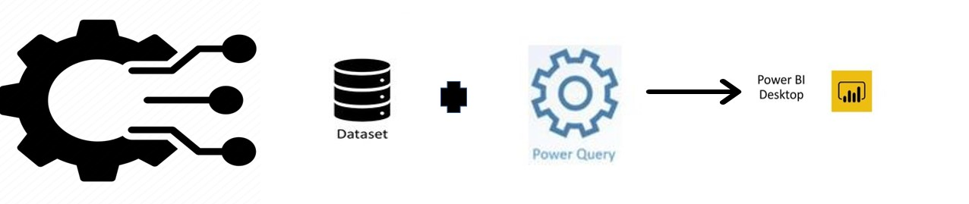
Power BI provides analysts with industry leading data preparation capabilities using Power Query(ETL)

Slide 9


